Slide 1
Adding Store Features: The Product Details

Slide 2
Displaying the Product Details
The obvious place to start is to display details for the products so that the customer can see what’s on offer.
The following code listing adds HTML elements to the store component’s template with data bindings that generate content for each product provided by the component.

Slide 3
Displaying the Product Details (continued)
Modify the store.component.html file in the src/app/store folder with the following highlighted changes:
<div class="container-fluid">
<div class="row">
<div class="col bg-dark text-white">
<a class="navbar-brand">SPORTS STORE</a>
</div>
</div>
<div class="row">
<div class="col-3 bg-info p-2 text-white">
{{ categories.length }} Categories
</div>
<div class="col-9 p-2">
<div *ngFor="let product of products" class="card m-1 p-1 bg-light">
<h4>
{{ product.name }}
<span class="badge badge-pill badge-primary float-right">
{{ product.price | currency: "USD":"symbol":"2.2-2" }}
</span>
</h4>
<div class="card-text bg-white p-1">{{ product.description }}</div>
</div>
</div>
</div>
</div>

Slide 4
Displaying the Product Details (continued)
Most of the elements control the layout and appearance of the content.
The most important change is the addition of an Angular data binding expression.
...
<div *ngFor="let product of products" class="card m-1 p-1 bg-light">
...
This is an example of a directive, which transforms the HTML element it is applied to.
This specific directive is called ngFor, and it transforms the div element by duplicating it for each object returned by the component’s products property.
Angular includes a range of built-in directives that perform the most commonly required tasks.

Slide 5
Displaying the Product Details (continued)
As it duplicates the div element, the current object is assigned to a variable called product, which allows it to be referred to in other data bindings, such as this one, which inserts the value of the current product’s name description property as the content of the div element:
...
<div class="card-text p-1 bg-white">{{product.description}}</div>
...

Slide 6
Displaying the Product Details (continued)
Not all data in an application’s data model can be displayed directly to the user.
Angular includes a feature called pipes, which are classes used to transform or prepare a data value for its use in a data binding.
There are several built-in pipes included with Angular, including the currency pipe, which formats number values as currencies, like this:
...
{{ product.price | currency:"USD":"symbol":"2.2-2" }}
...
The syntax for applying pipes can be a little awkward, but the expression in this binding tells Angular to format the price property of the current product using the currency pipe, with the currency conventions from the United States.

Slide 7
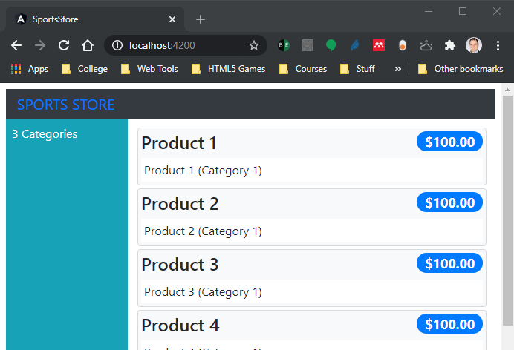
Displaying the Product Details (continued)
Save the changes to the template, and you will see a list of the products in the data model displayed as a long list:

Slide 8
Adding Category Selection
Modify the store.component.ts file in the src/app/store folder with the following highlighted changes:
import { Component } from '@angular/core';
import { Product } from '../model/product.model';
import { ProductRepository } from '../model/product.repository';
@Component({
selector: 'store',
templateUrl: 'store.component.html'
})
export class StoreComponent {
public selectedCategory = null;
constructor(private repository: ProductRepository) { }
get products(): Product[] {
return this.repository.getProducts(this.selectedCategory);
}
get categories(): string[] {
return this.repository.getCategories();
}
changeCategory(newCategory?: string): void {
this.selectedCategory = newCategory;
}
}

Slide 9
Adding Category Selection (continued)
The changes are simple because they build on the foundation that took so long to create at the start of the lesson.
The selectedCategory property is assigned the user’s choice of category (where null means all categories) and is used in the updateData method as an argument to the getProducts method, delegating the filtering to the data source.
The changeCategory method brings these two members together in a method that can be invoked when the user makes a category selection.

Slide 10
Adding Category Selection (continued)
Modify the store.component.html file in the src/app/store folder with the highlighted changes to provide the user with the set of buttons that change the selected category and show which category was picked:
<div class="container-fluid">
<div class="row">
<div class="col bg-dark text-white">
<a class="navbar-brand">SPORTS STORE</a>
</div>
</div>
<div class="row">
<div class="col-3 p-2">
<button class="btn btn-block btn-outline-primary" (click)="changeCategory()">
Home
</button>
<button *ngFor="let cat of categories"
class="btn btn-outline-primary btn-block"
[class.active]="cat == selectedCategory" (click)="changeCategory(cat)">
{{ cat }}
</button>
</div>
<div class="col-9 p-2">
<div *ngFor="let product of products" class="card m-1 p-1 bg-light">
<h4>
{{ product.name }}
<span class="badge badge-pill badge-primary float-right">
{{ product.price | currency: "USD":"symbol":"2.2-2" }}
</span>
</h4>
<div class="card-text bg-white p-1">{{ product.description }}</div>
</div>
</div>
</div>
</div>

Slide 11
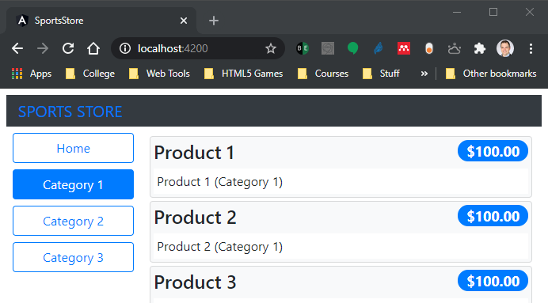
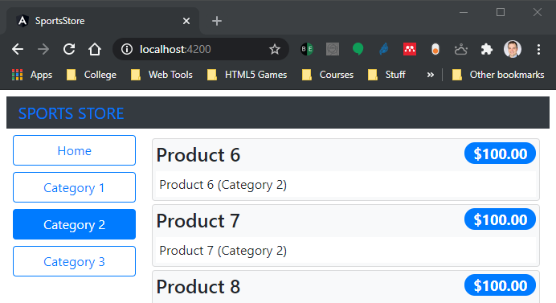
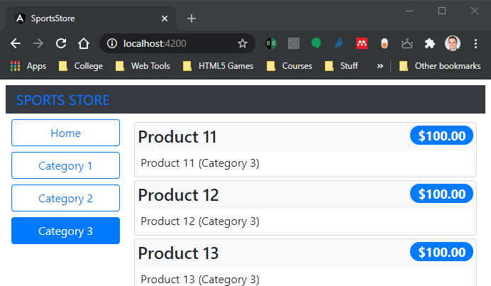
Adding Category Selection (continued)
These changes provide the user with visual feedback when the categories are filtered:

Slide 12
Adding Product Pagination
Filtering the products by category has helped make the product list more manageable, but a more typical approach is to break the list into smaller sections and present each of them as a page, along with navigation buttons that move between the pages.
Modify the store.component.ts file in the src/app/store folder with the following highlighted changes:
import { Component } from '@angular/core';
import { Product } from '../model/product.model';
import { ProductRepository } from '../model/product.repository';
@Component({
selector: 'store',
templateUrl: 'store.component.html'
})
export class StoreComponent {
public selectedCategory = null;
public productsPerPage = 4;
public selectedPage = 1;
constructor(private repository: ProductRepository) { }
get products(): Product[] {
const pageIndex = (this.selectedPage - 1) * this.productsPerPage;
return this.repository.getProducts(this.selectedCategory)
.slice(pageIndex, pageIndex + this.productsPerPage);
}

Slide 13
Adding Product Pagination (continued)
get categories(): string[] {
return this.repository.getCategories();
}
changeCategory(newCategory?: string): void {
this.selectedCategory = newCategory;
}
changePage(newPage: number): void {
this.selectedPage = newPage;
}
changePageSize(newSize: number): void {
this.productsPerPage = Number(newSize);
this.changePage(1);
}
get pageNumbers(): number[] {
return Array(Math.ceil(this.repository
.getProducts(this.selectedCategory).length / this.productsPerPage))
.fill(0).map((x, i) => i + 1);
}
}

Slide 14
Adding Product Pagination (continued)
There are two new features in the modified code listing.
The first is the ability to get a page of products, and the second is to change the size of the pages, allowing the number of products that each page contains to be altered.
There is a limitation in the built-in ngFor directive that Angular provides, which can generate content only for the objects in an array or a collection, rather than using a counter.

Slide 15
Adding Product Pagination (continued)
Since we need to generate numbered page navigation buttons, this means we need to create an array that contains the numbers we need, like this:
...
return Array(Math.ceil(this.repository.getProducts(this.selectedCategory).length
/ this.productsPerPage)).fill(0).map((x, i) => i + 1);
...
This statement creates a new array, fills it with the value 0, and then uses the map method to generate a new array with the number sequence.
This works well enough to implement the pagination feature, but it feels a little awkward.

Slide 16
Adding Product Pagination (continued)
Now, add the following code snippet to the store.component.html file in the src/app/store folder so that template implements the pagination feature.
...
<div class="card-text bg-white p-1">{{product.description}}</div>
</div>
<div class="form-inline float-left mr-1">
<select class="form-control" [value]="productsPerPage"
(change)="changePageSize($event.target.value)">
<option value="3">3 per Page</option>
<option value="4">4 per Page</option>
<option value="6">6 per Page</option>
<option value="8">8 per Page</option>
</select>
</div>
<div class="btn-group float-right">
<button *ngFor="let page of pageNumbers" (click)="changePage(page)"
class="btn btn-outline-primary"
[class.active]="page == selectedPage">
{{page}}
</button>
</div>
...

Slide 17
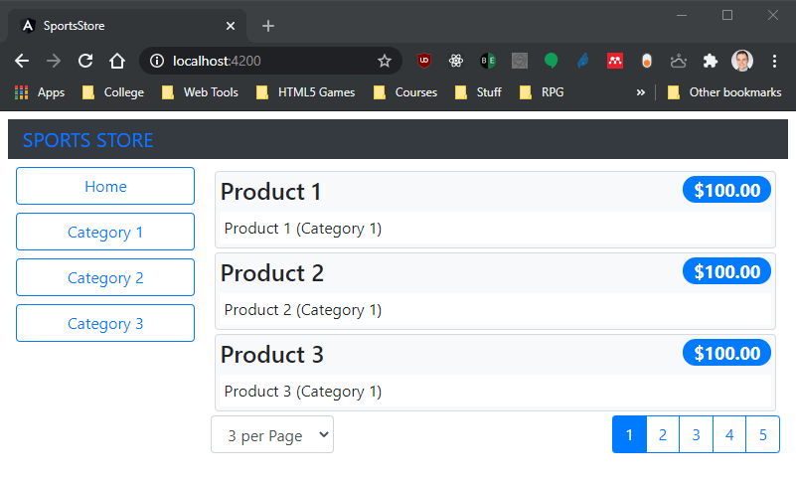
Adding Product Pagination (continued)
The new elements add a select element that allows the size of the page to be changed and a set of buttons that navigate through the product pages.
The new elements have data bindings to wire them up to the properties and methods provided by the component.
The result is a more manageable set of products:

Slide 18
Creating a Custom Directive
In this section, we are going to create a custom directive so that we don’t have to generate an array full of numbers to create the page navigation buttons.
Angular provides a good range of built-in directives, but it is a simple process to create your own directives to solve problems that are specific to your application or to support features that the built-in directives don’t have.

Slide 19
Creating a Custom Directive (continued)
Create a file called counter.directive.ts in the src/app/store folder and include the following code:
import {
Directive, ViewContainerRef, TemplateRef, Input, Attribute, SimpleChanges} from '@angular/core';
@Directive({
selector: '[counterOf]'
})
export class CounterDirective {
constructor(private container: ViewContainerRef,
private template: TemplateRef<any>) {
}
@Input('counterOf')
counter: number;
ngOnChanges(changes: SimpleChanges): void {
this.container.clear();
for (let i = 0; i < this.counter; i++) {
this.container.createEmbeddedView(this.template,
new CounterDirectiveContext(i + 1));
}
}
}
class CounterDirectiveContext {
constructor(public $implicit: any) { }
}

Slide 20
Creating a Custom Directive (continued)
The above code is an example of a structural directive which is applied to elements through a counter property.
The directive relies on special features that Angular provides for creating content repeatedly, just like the built-in ngFor directive.
In this case, rather than yield each object in a collection, the custom directive yields a series of numbers that can be used to create the page navigation buttons.

Slide 21
Creating a Custom Directive (continued)
To use the directive, it must be added to the declarations property of its feature module.
Modify the store.module.ts file in the src/app/store folder with the following highlighted code:
import { NgModule } from '@angular/core';
import { BrowserModule } from '@angular/platform-browser';
import { FormsModule } from '@angular/forms';
import { ModelModule } from '../model/model.module';
import { StoreComponent } from './store.component';
import { CounterDirective } from './counter.directive';
@NgModule({
imports: [ModelModule, BrowserModule, FormsModule],
declarations: [StoreComponent, CounterDirective],
exports: [StoreComponent, CounterDirective]
})
export class StoreModule { }

Slide 22
Creating a Custom Directive (continued)
Now that the directive has been registered, it can be used in the store component’s template to replace the ngFor directive. Modify the store.component.html file in the src/app/store folder with the highlighted code:
...
<option value="8">8 per Page</option>
</select>
</div>
<div class="btn-group float-right">
<button *counter="let page of pageCount" (click)="changePage(page)"
class="btn btn-outline-primary"
[class.active]="page == selectedPage">
{{page}}
</button>
</div>
...

Slide 23
Creating a Custom Directive (continued)
The new data binding relies on a property called pageCount to configure the custom directive. Replace the array of numbers with a simple number that provides the expression value in the store.component.ts file in the src/app/store folder.
...
changePageSize(newSize: number): void {
this.productsPerPage = Number(newSize);
this.changePage(1);
}
get pageCount(): number {
return Math.ceil(this.repository
.getProducts(this.selectedCategory).length / this.productsPerPage);
}
/* get pageNumbers(): number[] {
return Array(Math.ceil(this.repository
.getProducts(this.selectedCategory).length / this.productsPerPage))
.fill(0).map((x, i) => i + 1);
} */
...

Slide 24
Creating a Custom Directive (continued)
There is no visual change to the SportsStore application, but this section has demonstrated that it is possible to supplement the built-in Angular functionality with custom code that is tailored to the needs of a specific project.

